Slide 1





#semanticClimate
Peter Murray-Rust
Yusuf Hamied Dept of Chemistry,
University of Cambridge
#semanticClimate hackathon, NIPGR IN, 2022-09-24

Slide 2
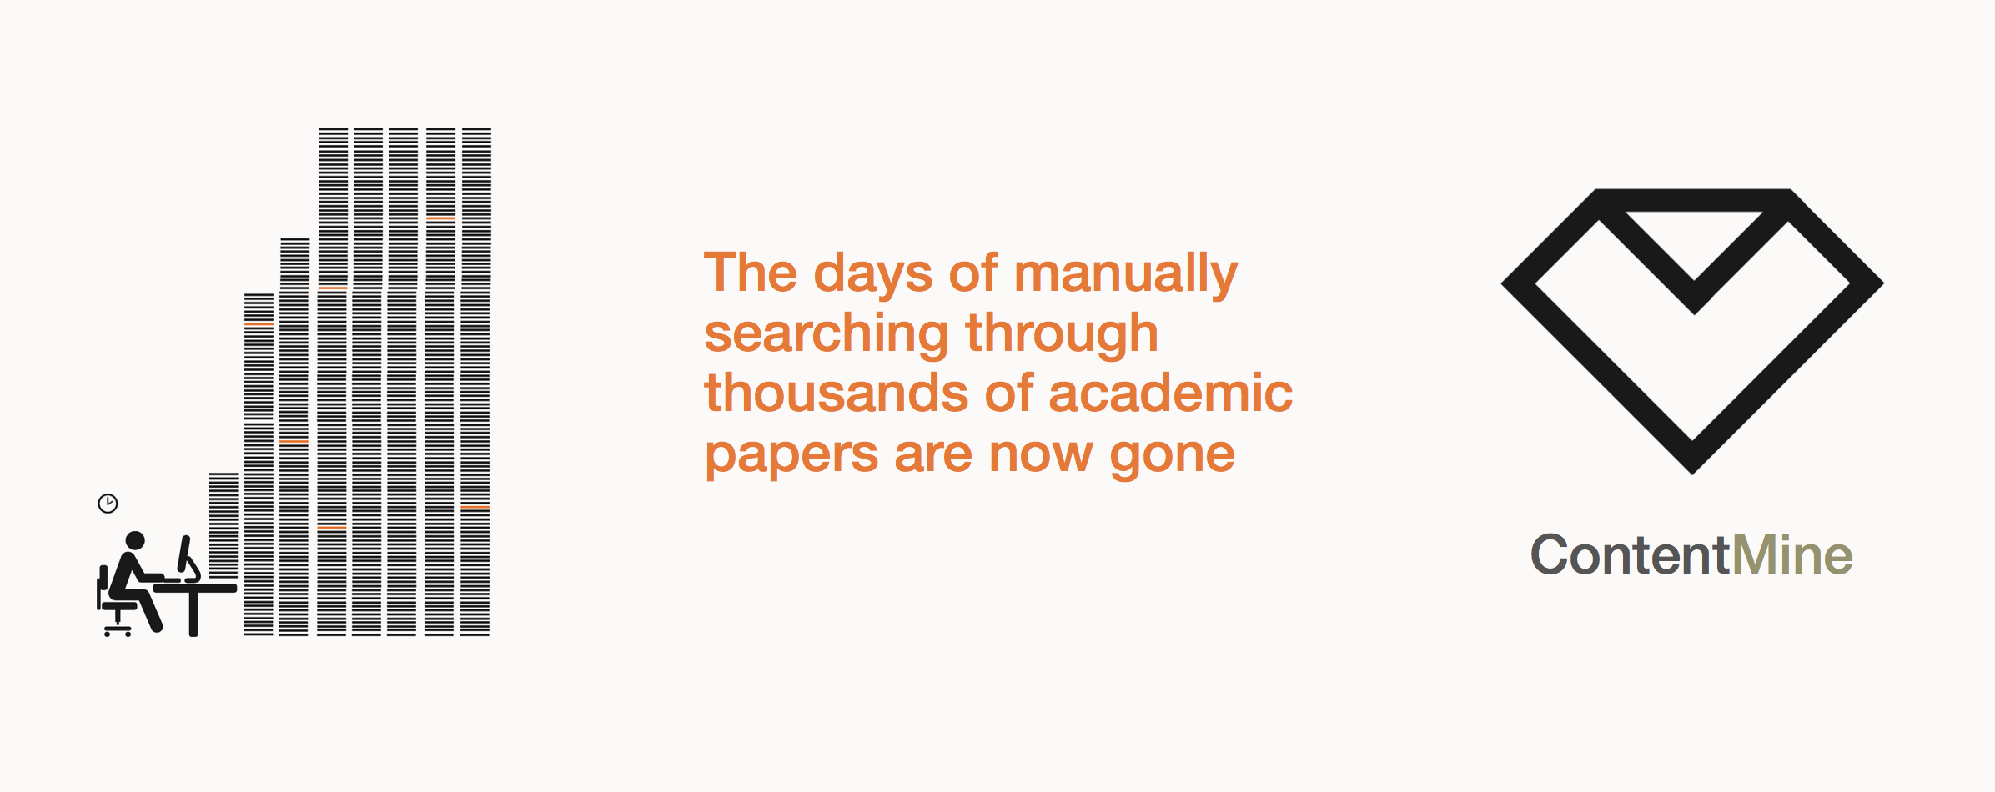
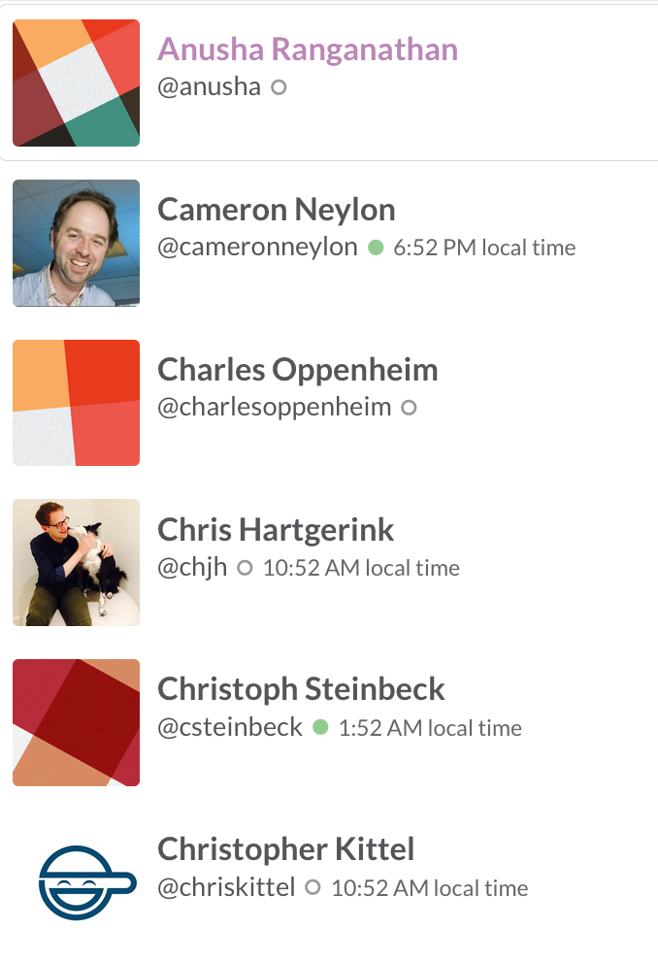
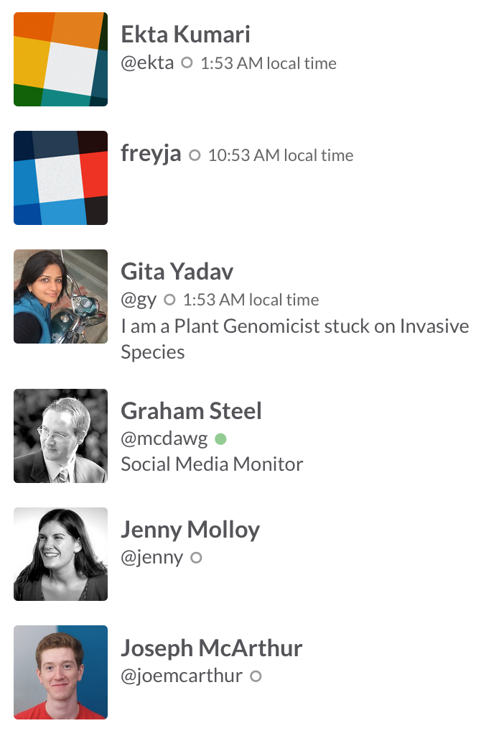
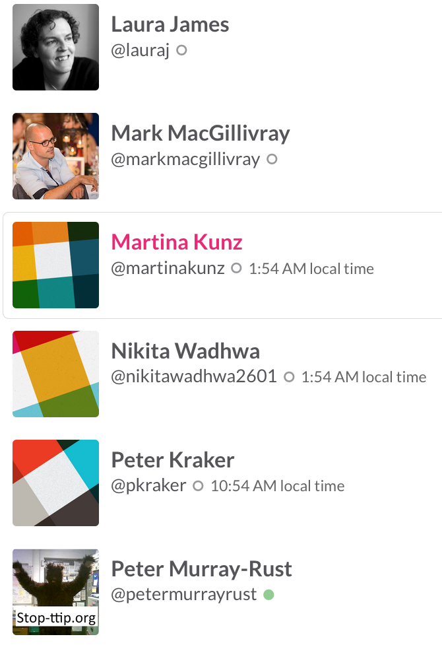
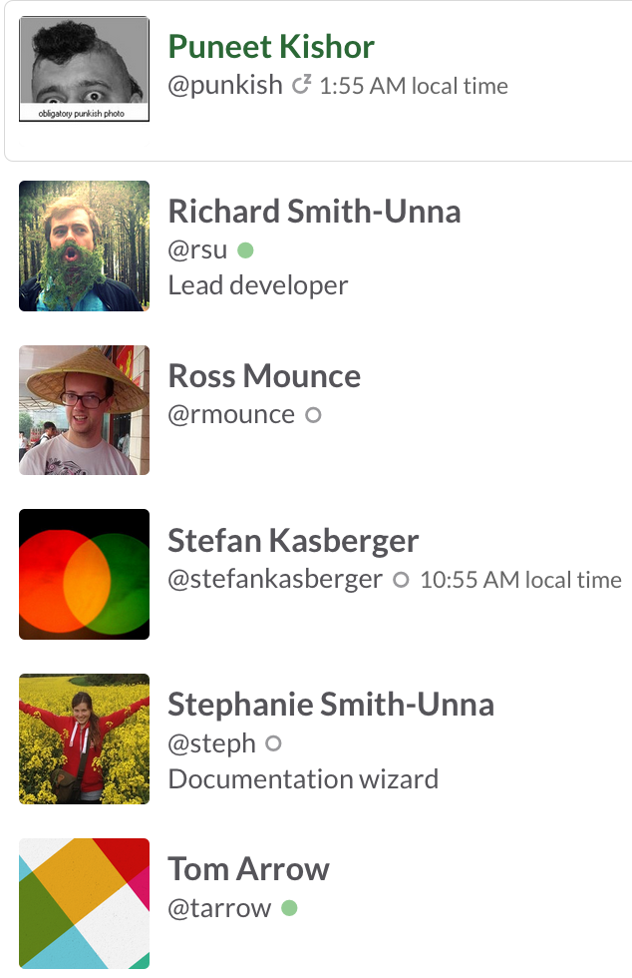
The Right to Read is the Right to Mine
ContentMining (TDM) 2013-
(2x digital music industry!)

Slide 3
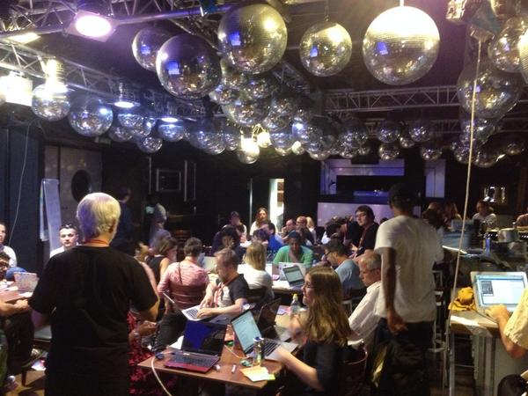
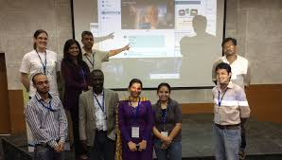
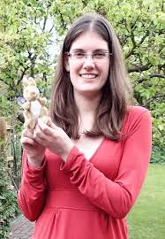
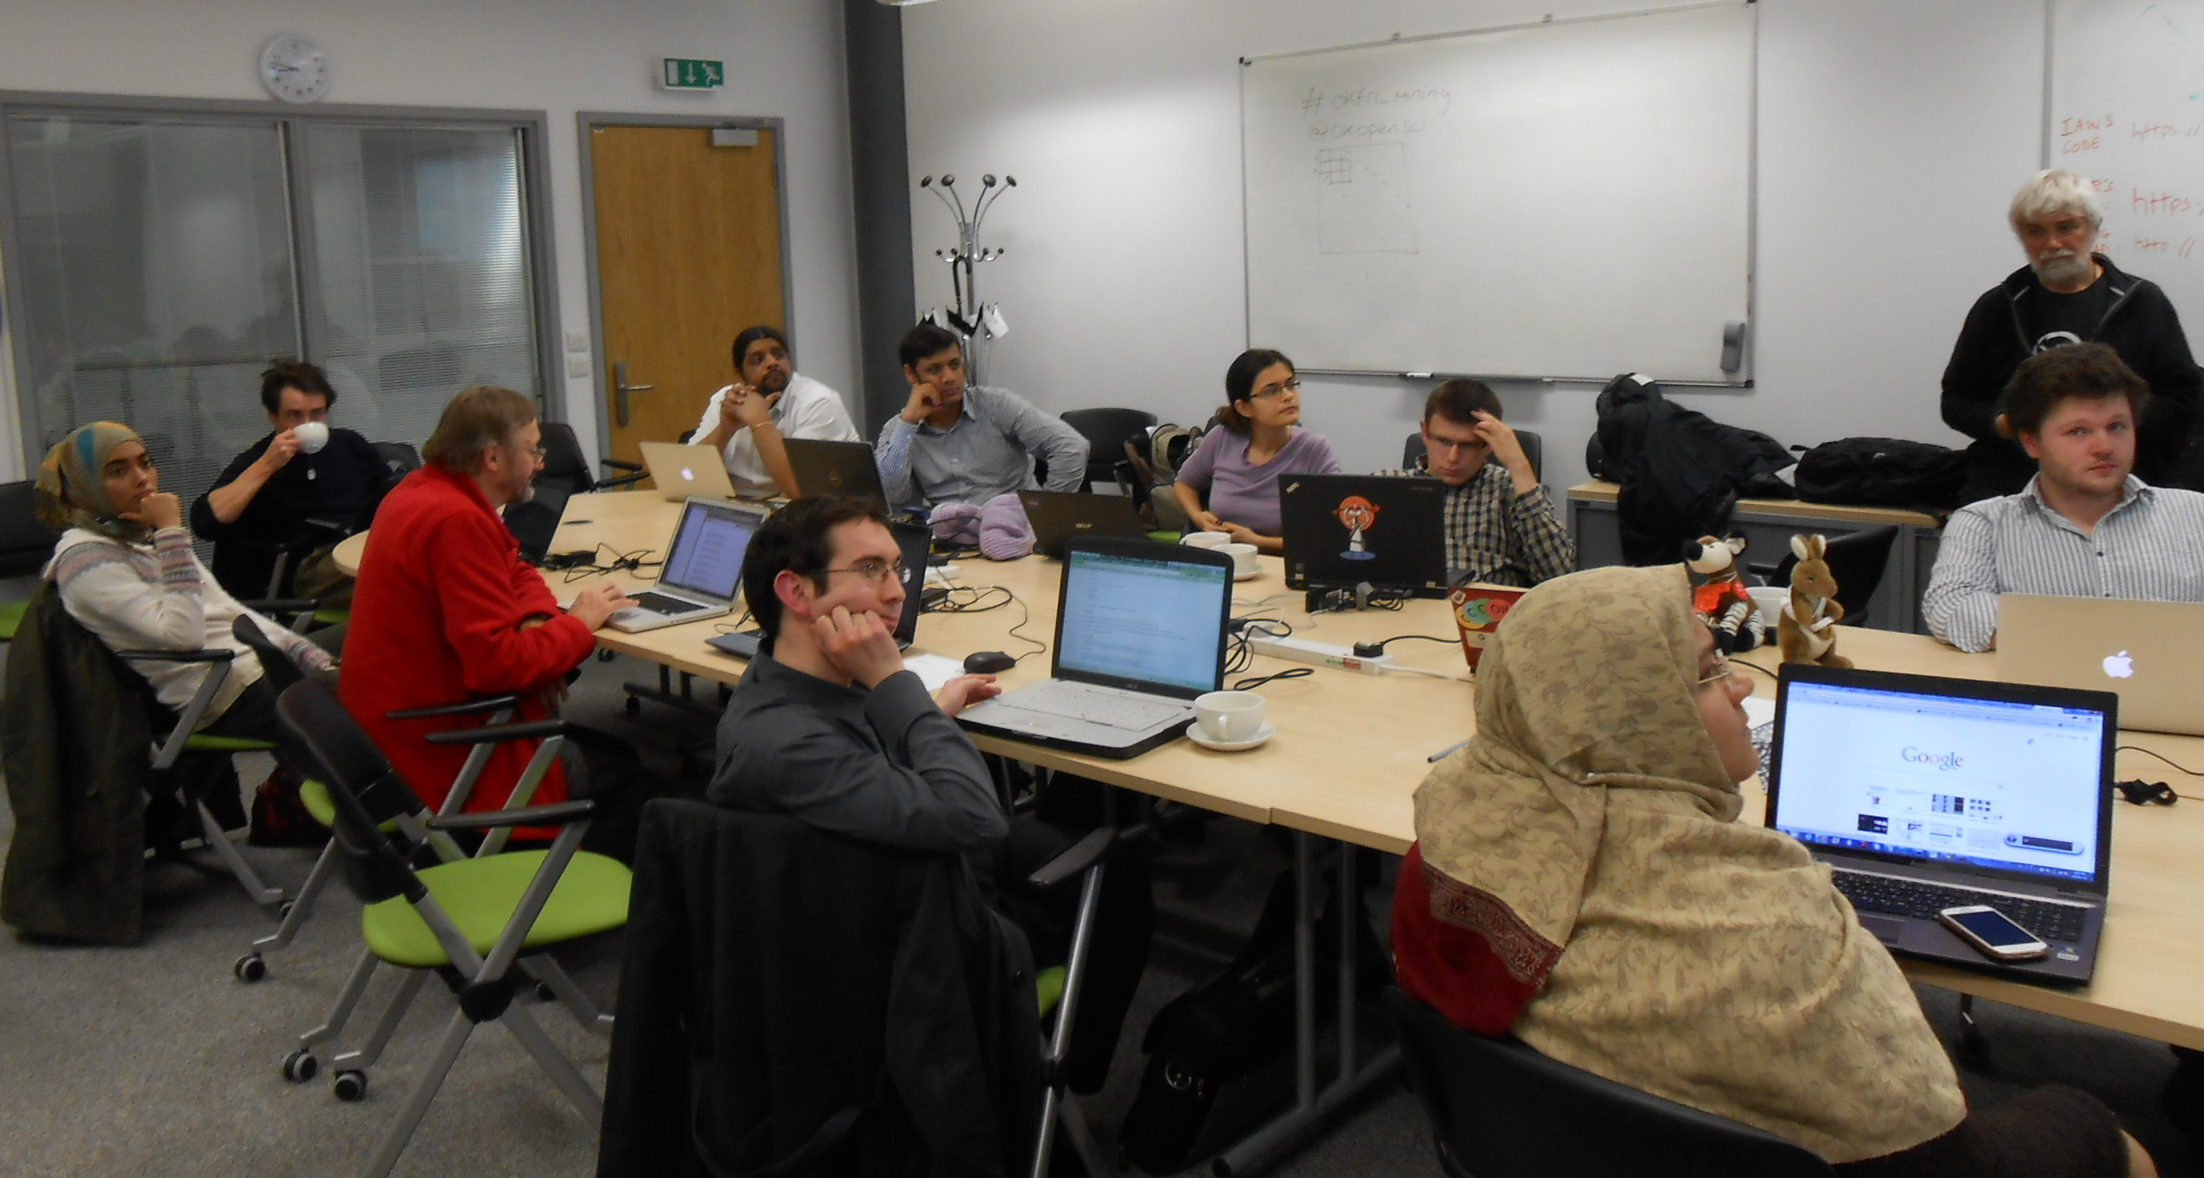
Berlin 2014
Gita Yadav + colleagues
Delhi 2014
Oxford 2013
Jenny Molloy with mascot AMI

Slide 4
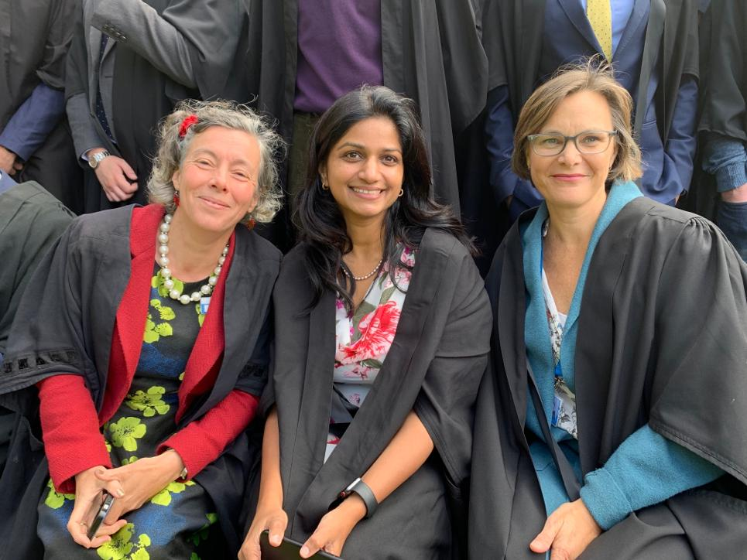
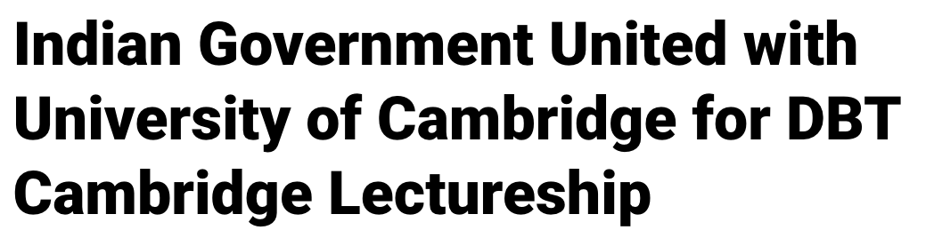
St Edmunds College, Cambridge

Slide 5
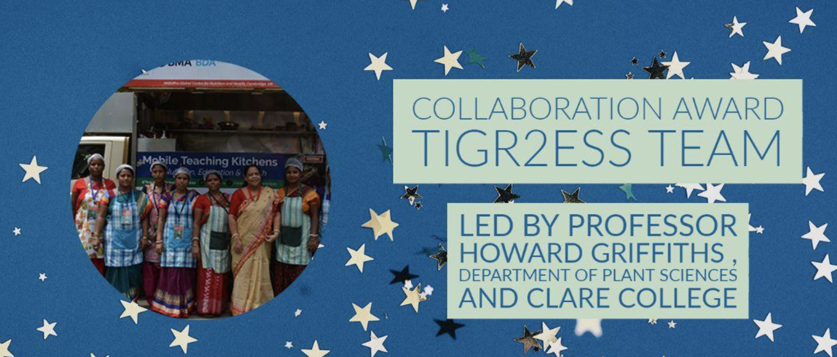
Cambridge-India and TIGR2ESS
TIGR2ESS NIPGR Food Security FEB 2019
Vice Chancellors Award 2022

Slide 6
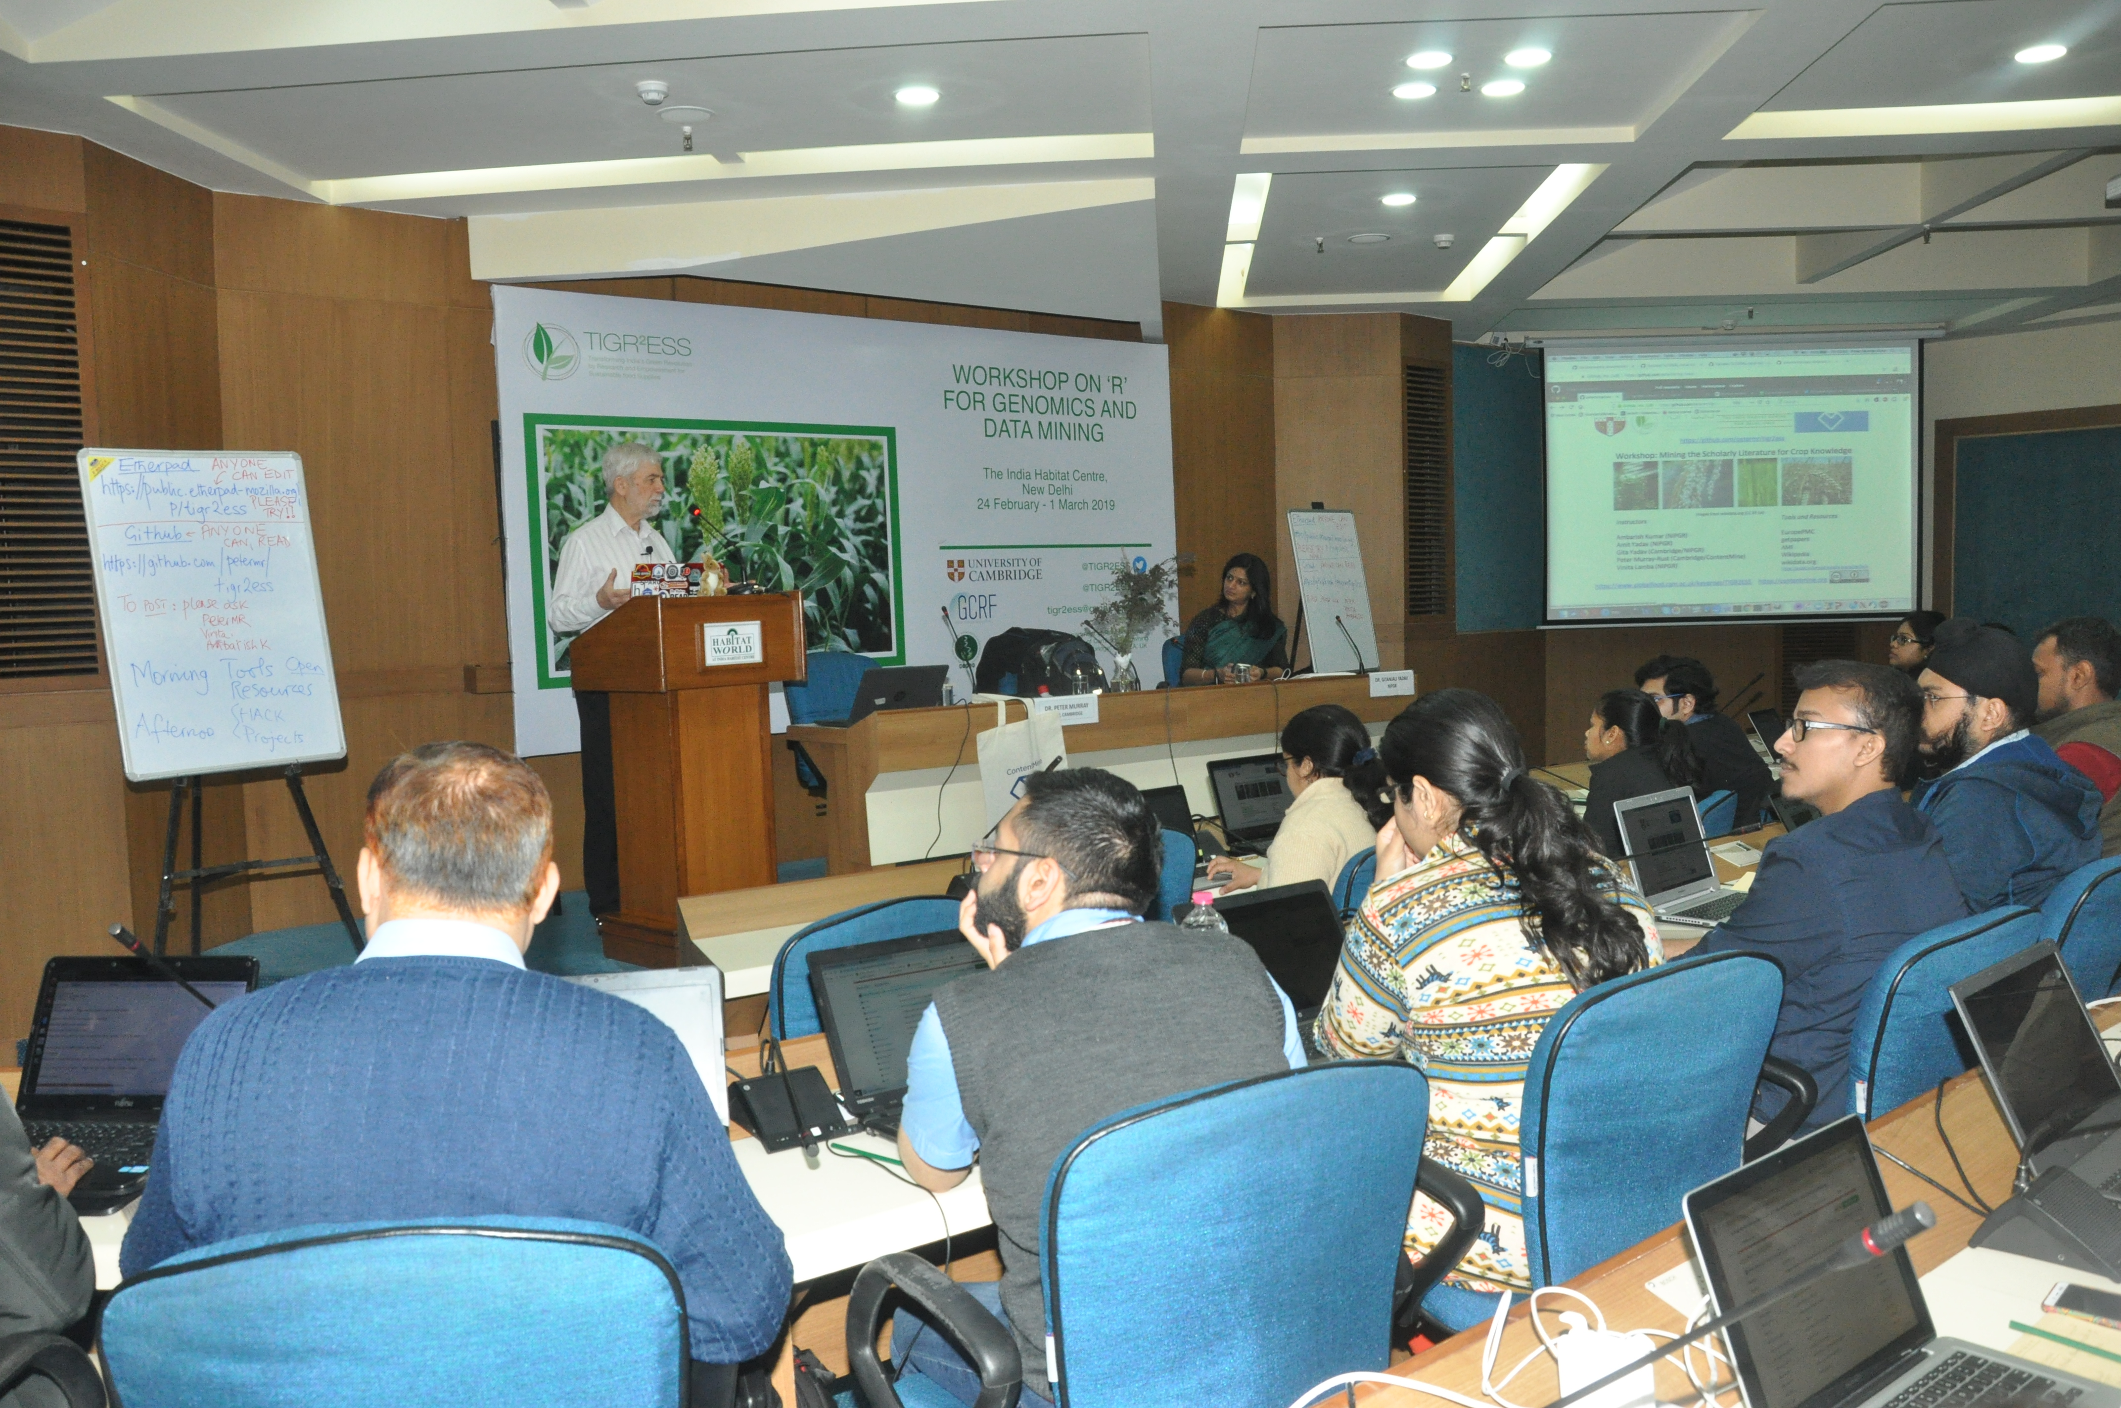
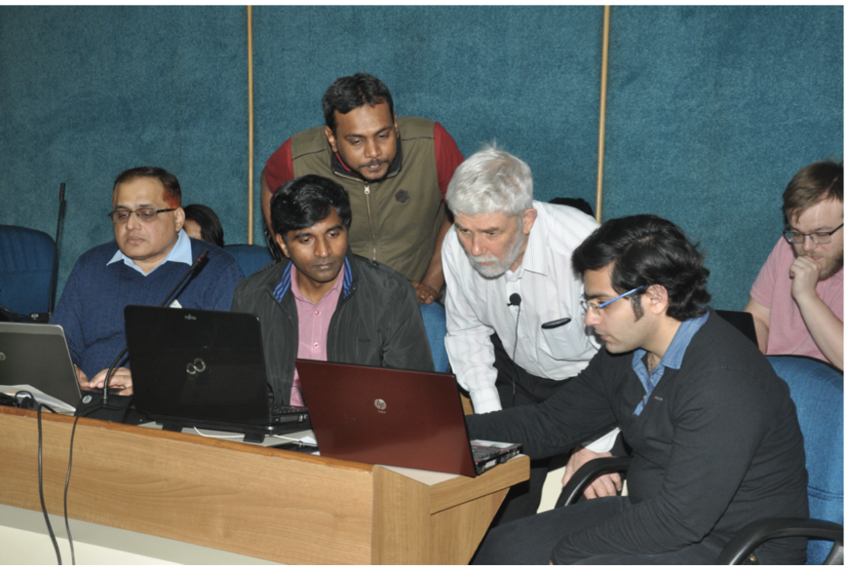
TIGR2ESS 2019 NIPGR
Text mining for Indian crops
Parallel Activities
* Rice
* Millets * Wheat
50 delegates from all India

Slide 7
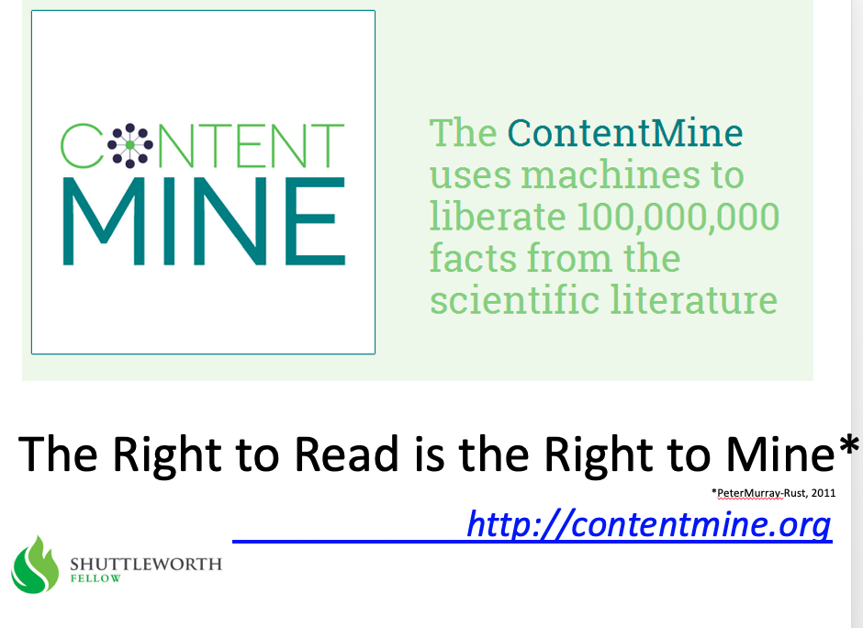
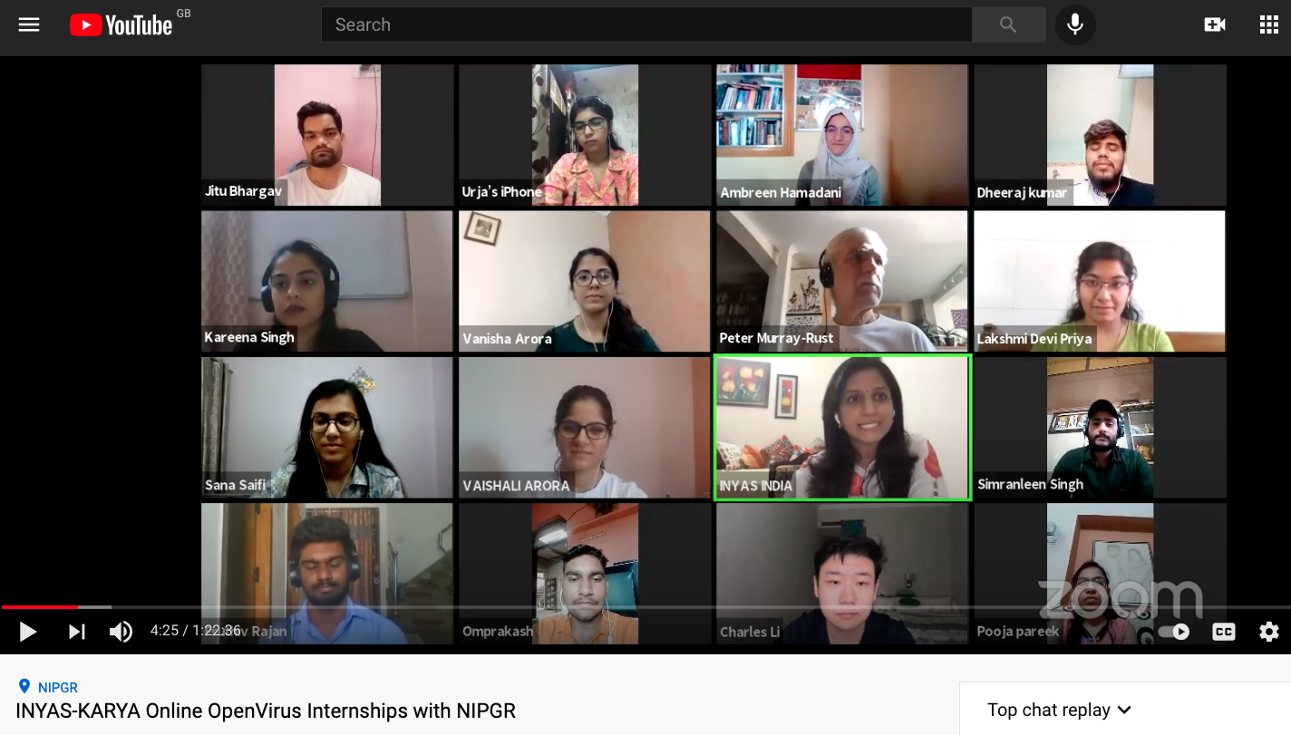
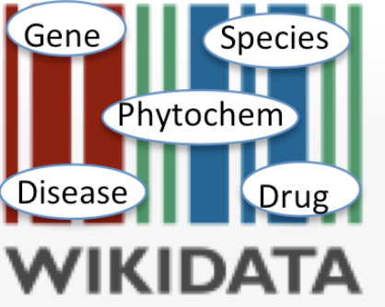
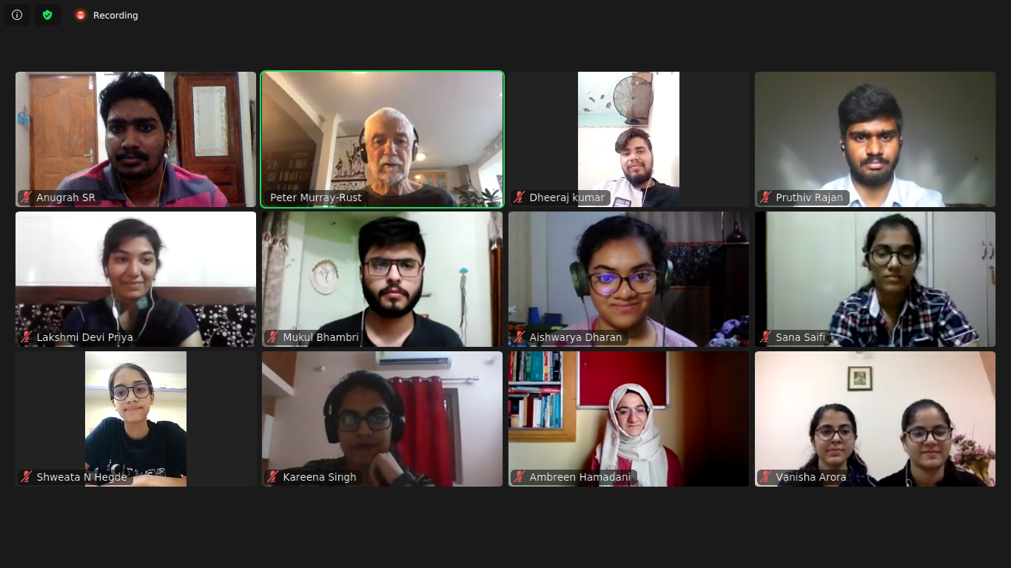
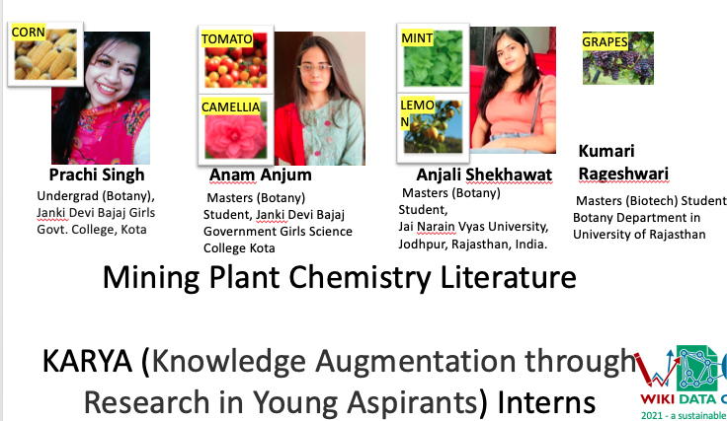
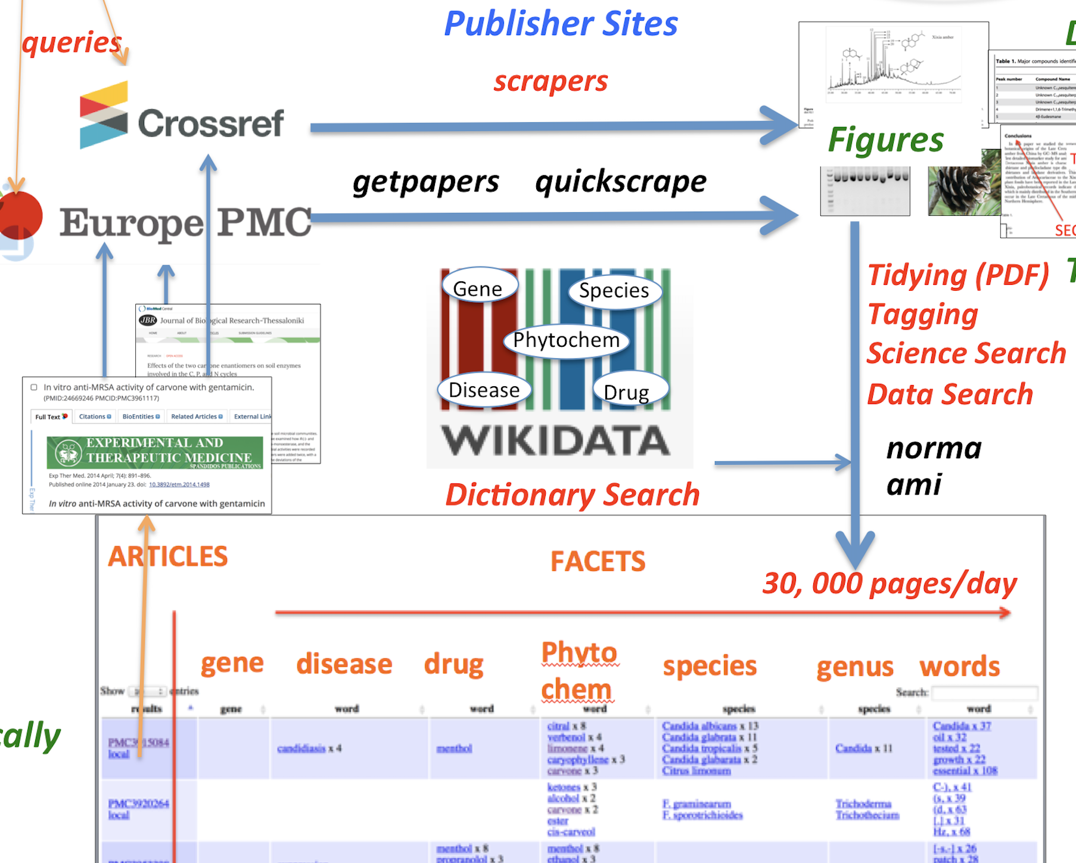
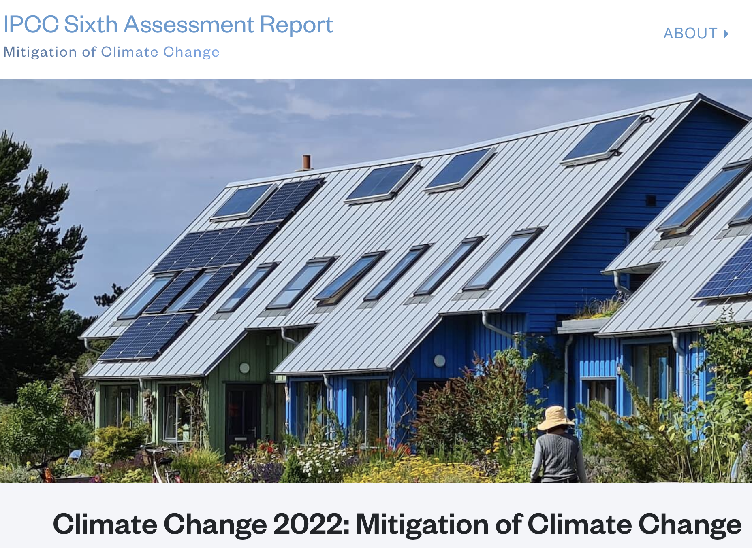
+
2013
Delhi 2014
TIGR2ESS 2019
INYAS* 5 interns Aug 2020
OpenVirus 8
Priya, Kareena interns JUNE 2020
cambiohack
InCoB (China)
WikidataCon (Brazil)
CEVOpen 2021
DBT KARYA 4
OpenPlant
Cambridge
#semanticClimate
SDG Hackathon June2022
ClimateKnowledgeHunt
Sept2022
April2022
https://www.youtube.com/watch?v=XiTngk-POm8&ab_channel=INYASYouTube
#semanticClimate publications

Slide 8
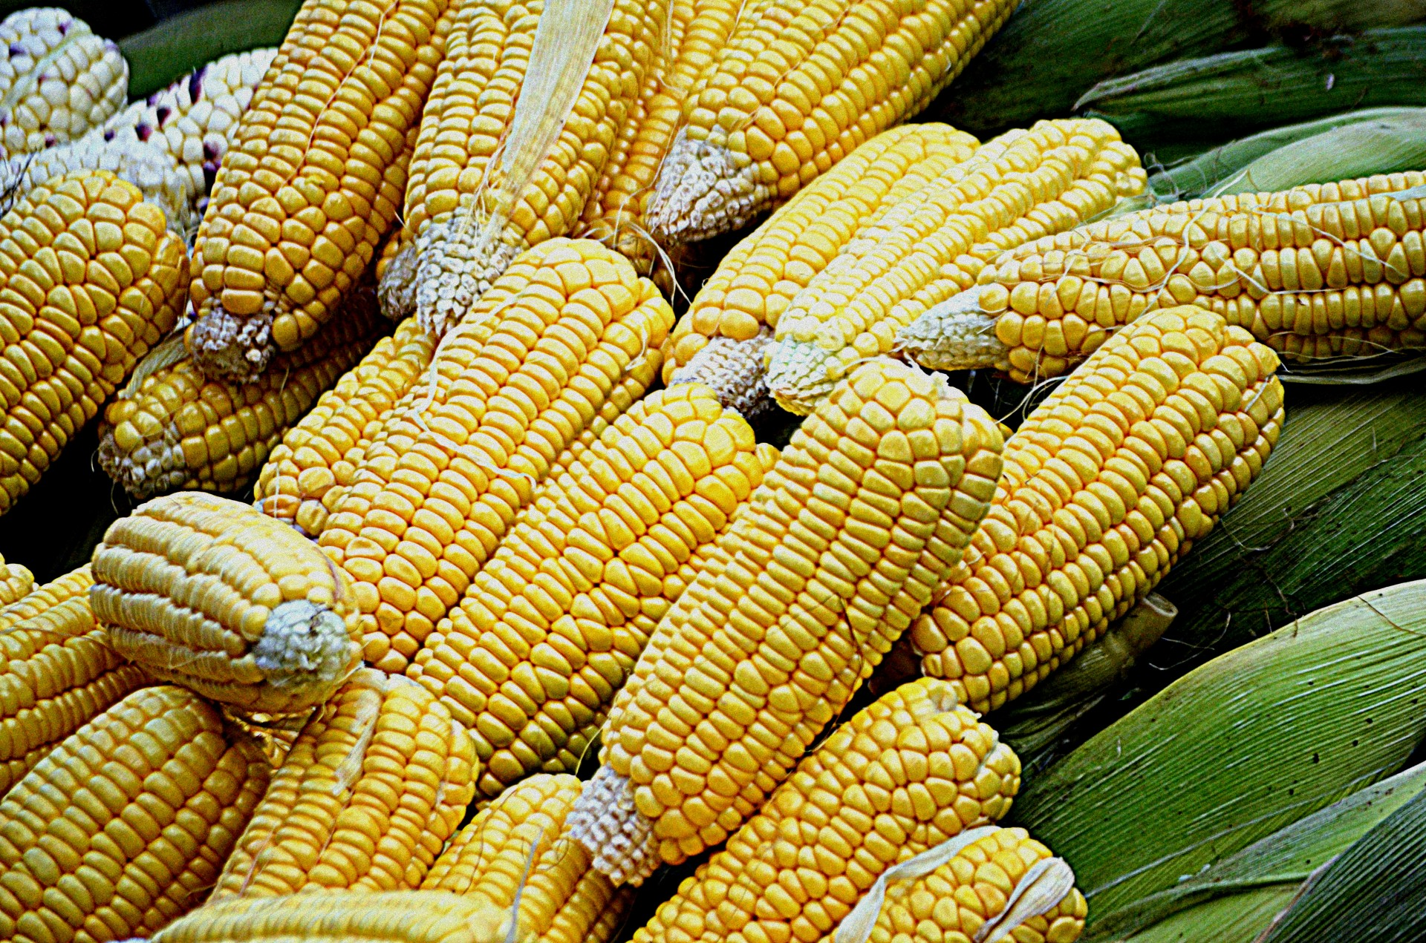
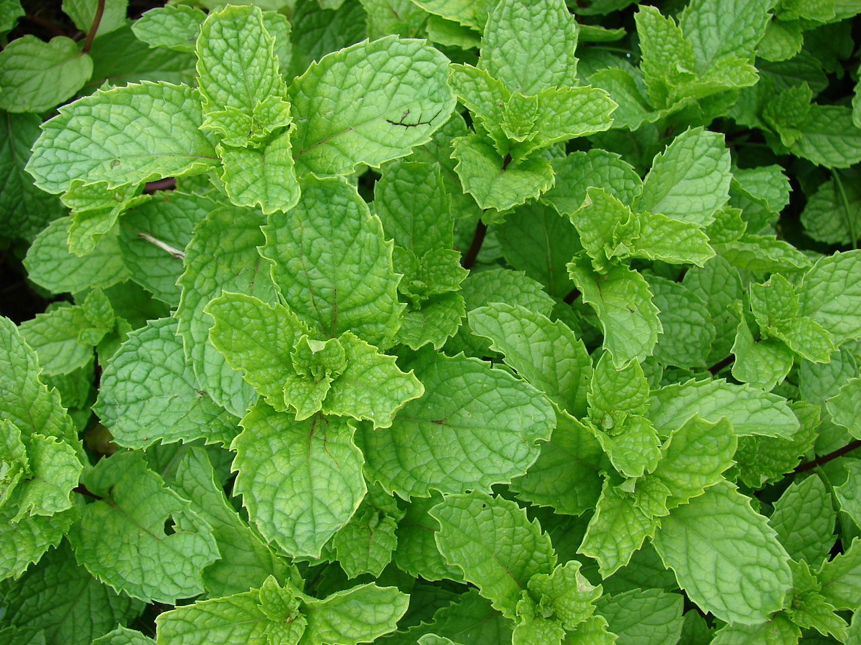
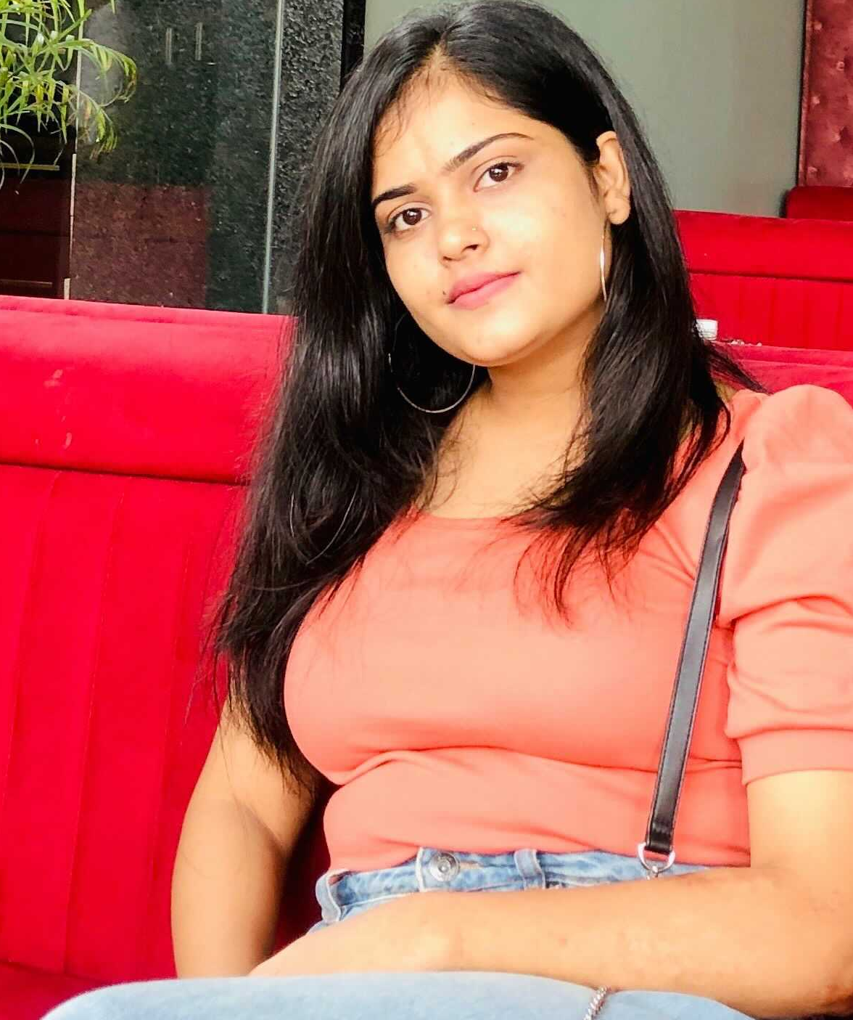
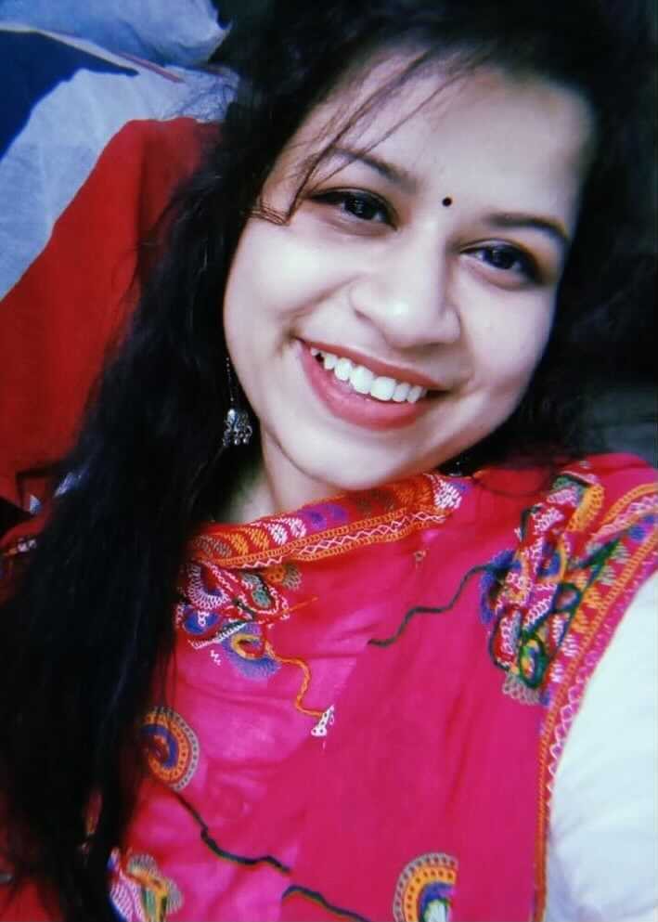
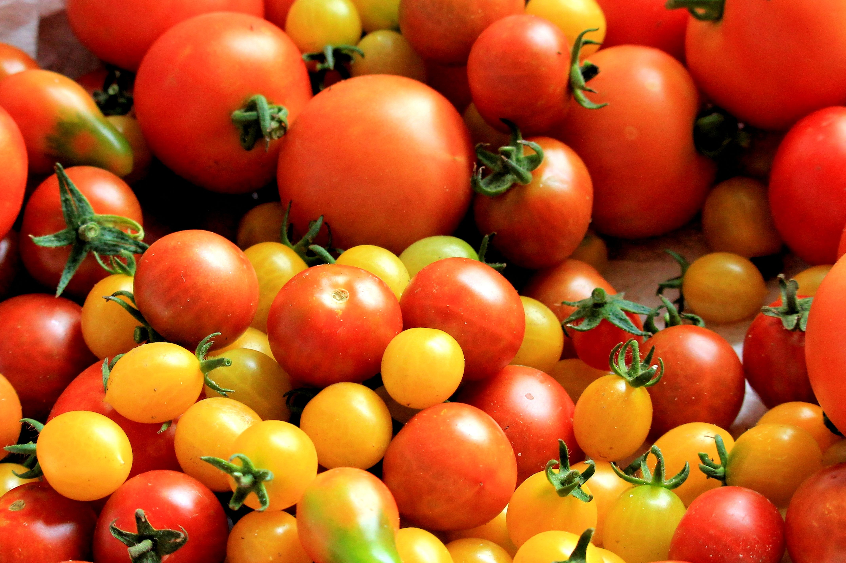
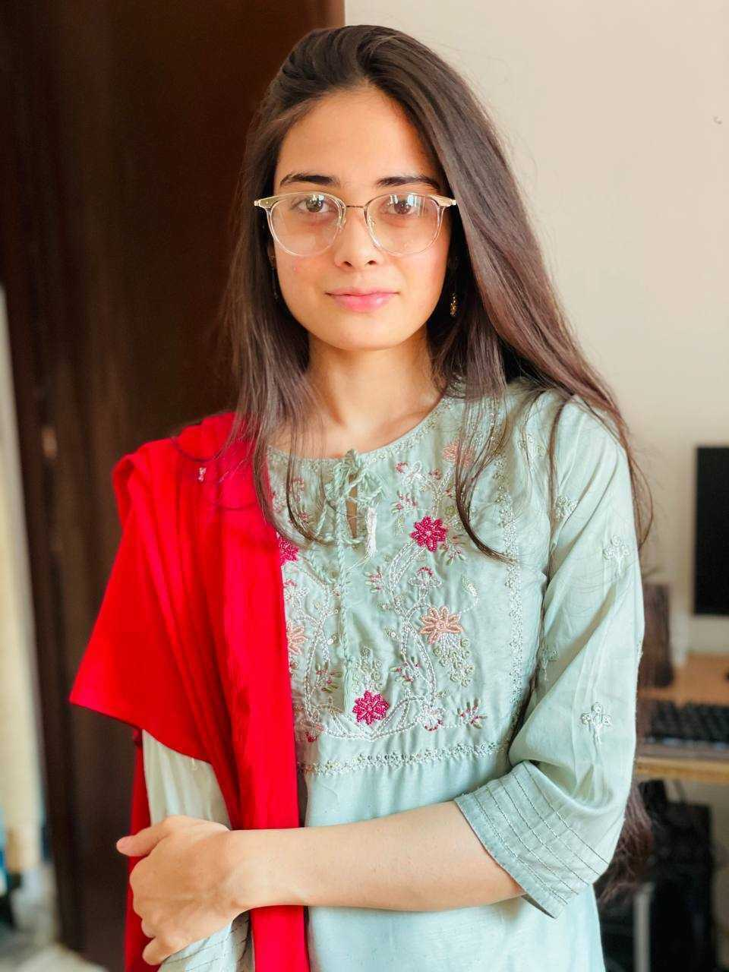
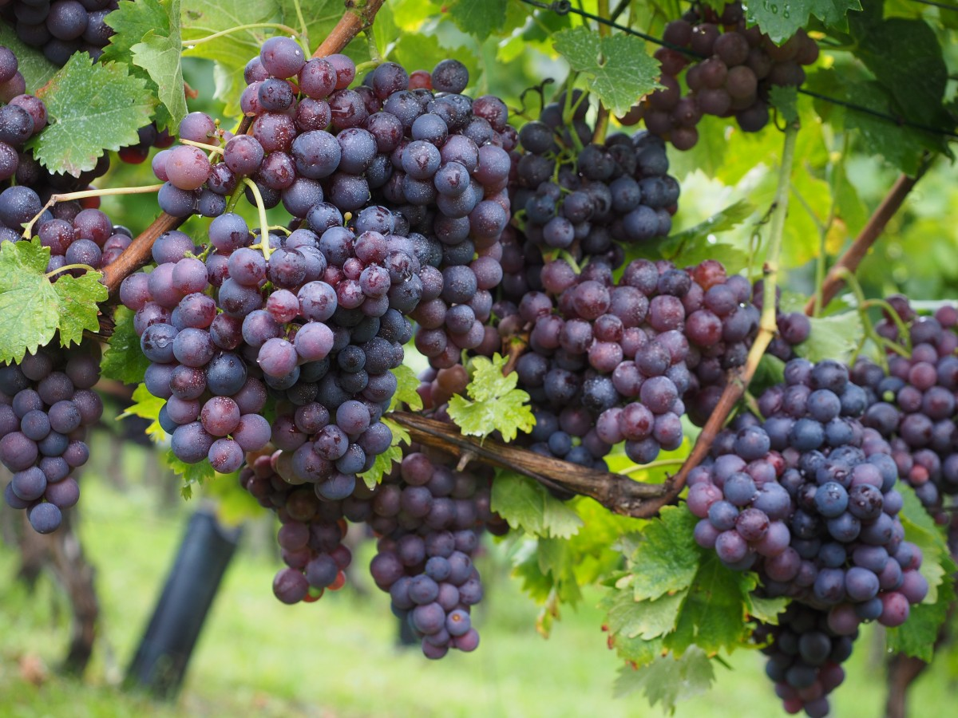

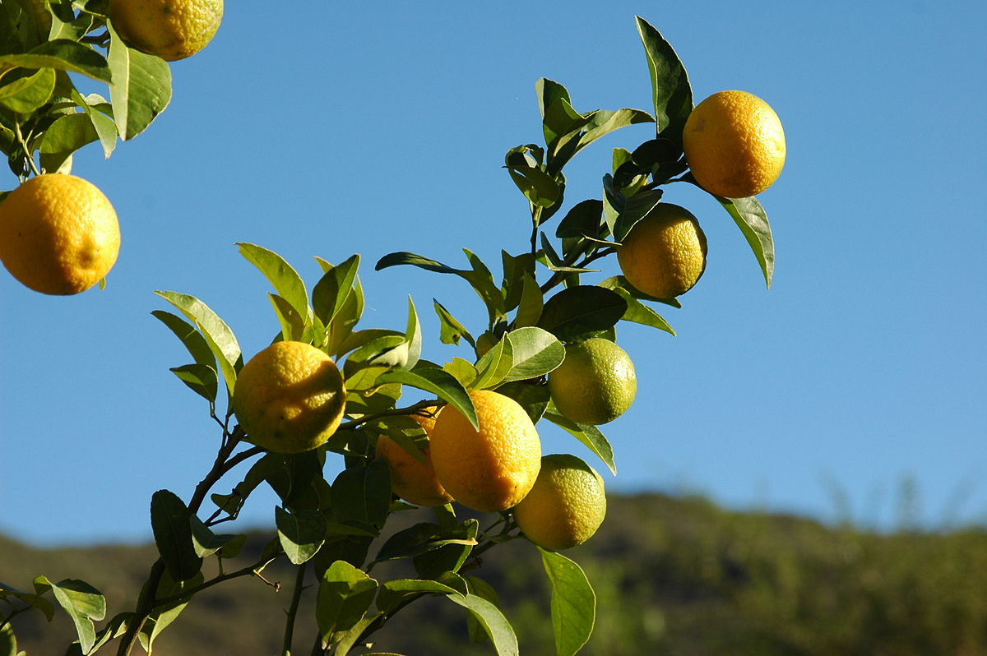

CORN
TOMATO
MINT
GRAPES
CAMELLIA
LEMON
Kumari Rageshwari
Prachi Singh
Anam Anjum
Anjali Shekhawat
Undergrad (Botany), Janki Devi Bajaj Girls Govt. College, Kota
Masters (Botany) Student, Janki Devi Bajaj Government Girls Science College Kota
Masters (Botany) Student,
Jai Narain Vyas University,
Jodhpur, Rajasthan, India.
Masters (Biotech) Student,
Botany Department in University of Rajasthan
Mining Plant Chemistry Literature
KARYA (Knowledge Augmentation through Research in Young Aspirants) Interns
2021 - a sustainable future for Wikidata
https://en.wikipedia.org/wiki/Terpene_synthase_N_terminal_domain , CC BY-SA
Notes:
This Photo by Unknown Author is licensed under CC BY-SA

Slide 9

Content mining of the biomedical literature
Peter Murray-Rust,
Yusuf Hamied Dept of Chemistry, University of Cambridge,
with Shweata N Hegde, Ayush Garg, Prachi Singh, Anuv Chakraborty, Rageshwari Singh
InCoB (Int. Conf. on Bioinformatics) , 2021-11-07
Typical event 2021

Slide 10
How we work
Open Notebook Science *
- Everything uploaded to Github immediately
Agile teams (daily report)
Often parallel (emissions, AFOLU, Urban)
Teach and support each other
Workshops, interns, volunteers
* https://en.wikipedia.org/wiki/Open-notebook_science Thanks to Jean-Claude Bradley

Slide 11
Hackathons…
Outreach!
serendipitous encounters
Joined by Ayush Garg
Cambiohack
Notes:
Traffic Lights -> Spreadsheet + literal traffic light
Daily Stand-ups
What I did
What next
Blockers
Community
Icons > Textual information

Slide 12
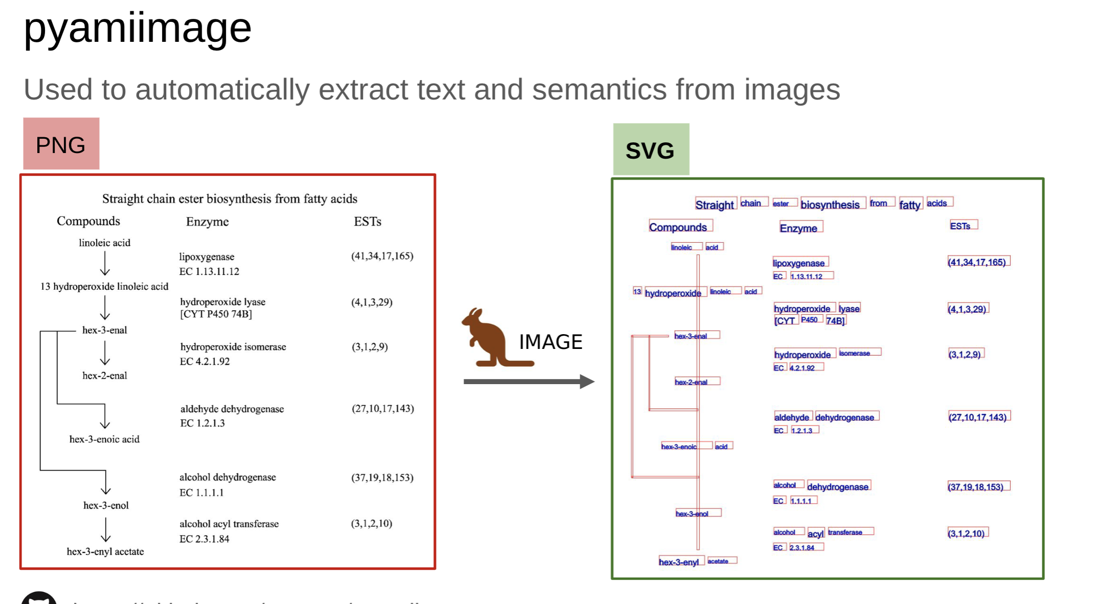
TextMining from Images!
Anubhah Chakraborty will demo in the Hackroom

Slide 13
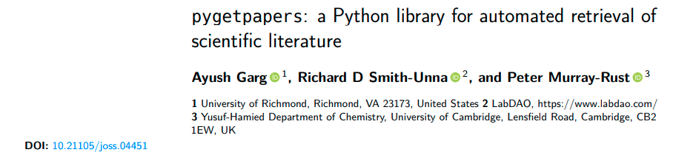

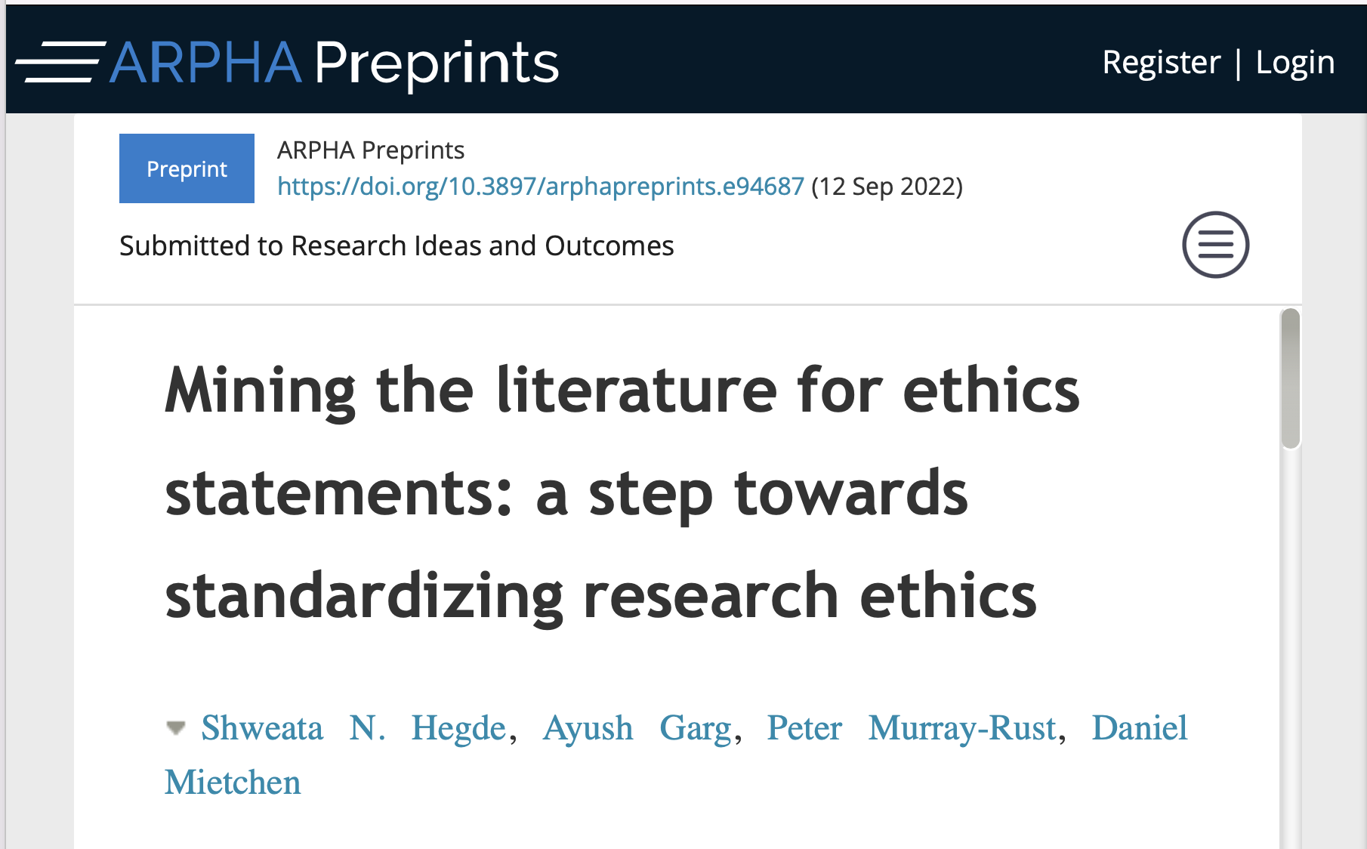
#semanticClimate publications

Slide 15
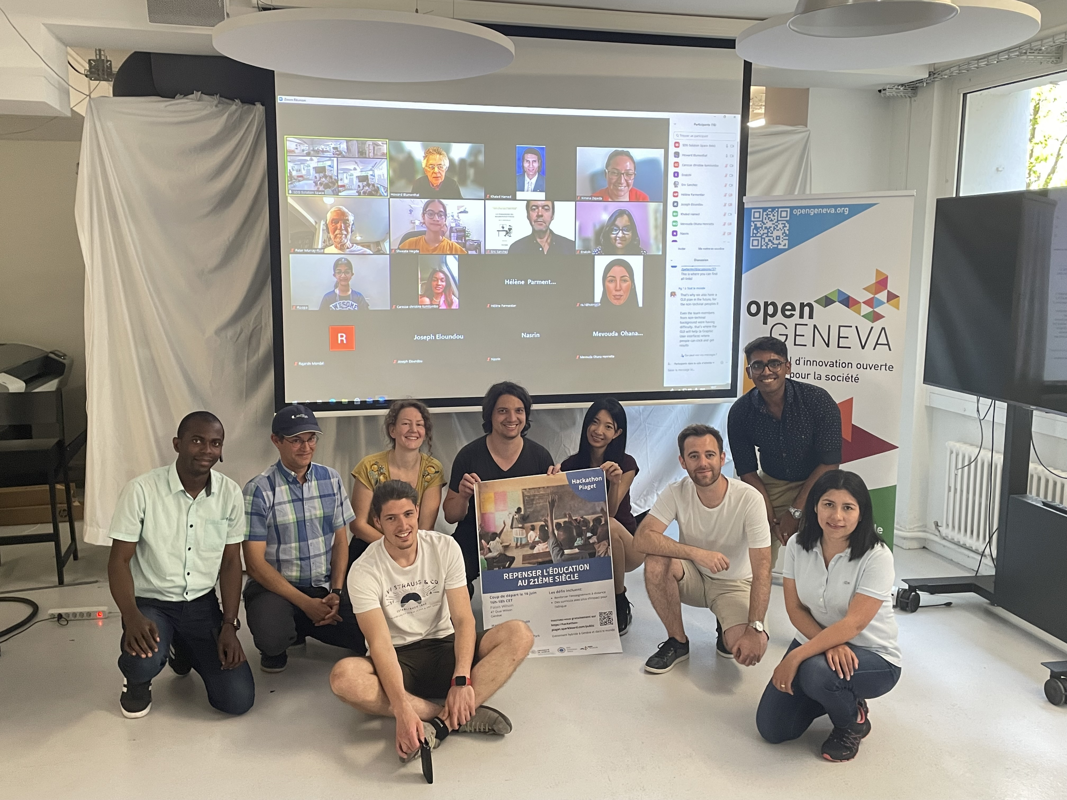
Hackathon Piaget, UN+Univ Geneva, SDG Accelerator, June 2022

Slide 16

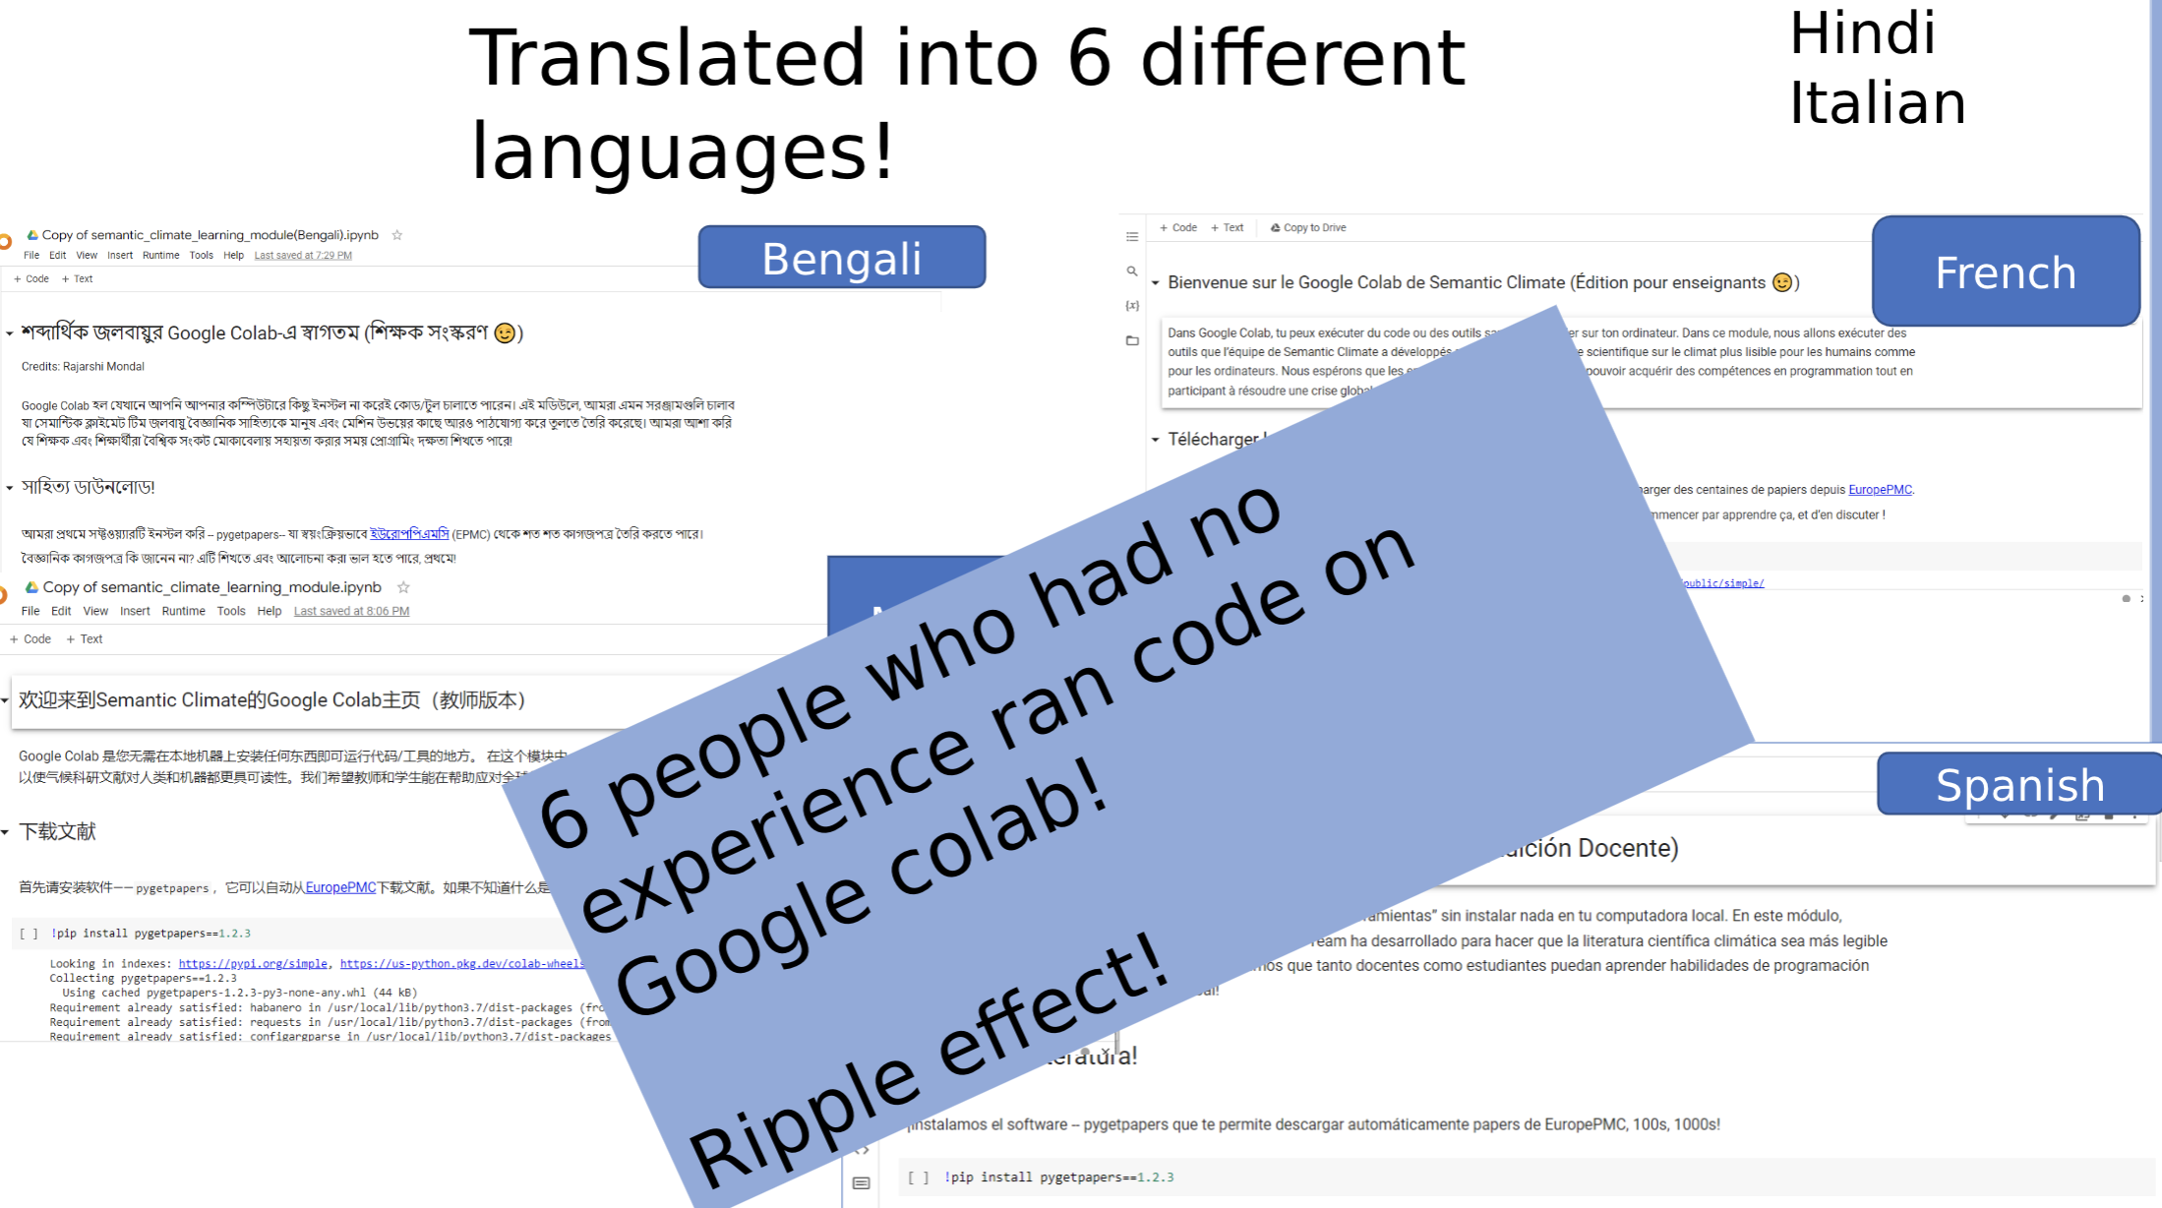
Shweata H Hegde
Ananya Singha

Slide 17
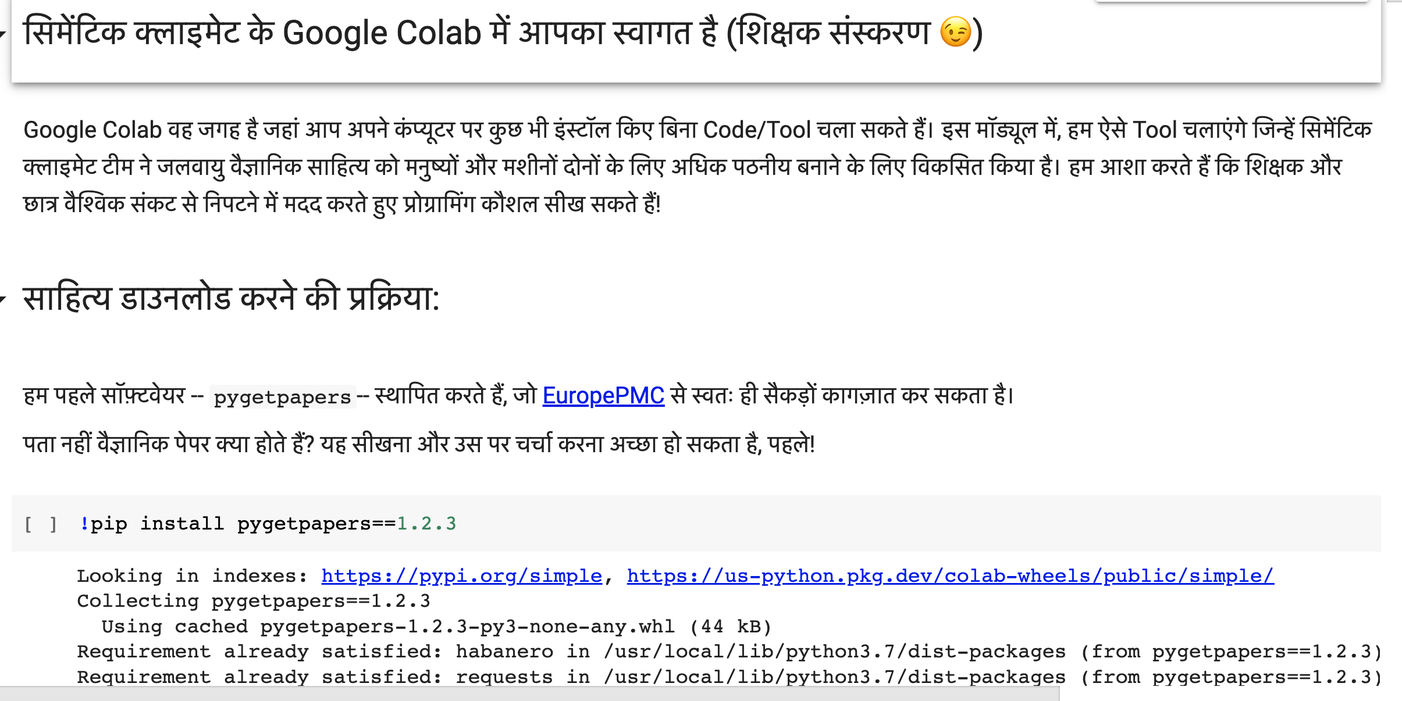
Discussion Thread with multilingual Notebooks: https://github.com/petermr/petermr/discussions/37#discussioncomment-2972553

Slide 18
Team #semanticClimate won!
Shweata N Hegde: SDG Accelerator
Plan: Hackathons
Sept 2023 virtual
Jan 2023 virtual
Mar 2023 NIPGR (India 75th anniv)
Climate “Carpentries”* Summer 2023
Geneva
Hannover
Cambridge
* Inspired by SoftwareCarpentry

